Slide 1
UNIT 7 FUNCTION LH – 5HRS
PRESENTED BY:
ER. SHARAT MAHARJAN
C PROGRAMMING

Slide 2
CONTENTS (LH – 5HRS)
7.1 Introduction, Components,
7.2 Function Parameters,
7.3 Library Function vs User Defined Function,
7.4 Different forms of functions,
7.5 Recursion,
7.6 Passing Array to Function, Passing String to Function,
7.7 Accessing a function (Call by Value and Call by Reference),
7.8 Macros, Storage Class.

Slide 3
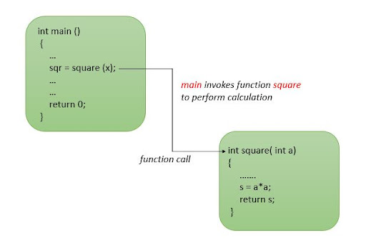
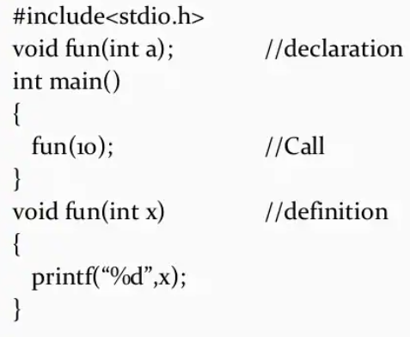
7.1 Introduction, Components
A function is a block of code that performs a specific task. C allows us to define functions according to our need. These functions are known as user-defined functions.
It can be accessed from any location within a C-program.
The function main() is always present in every C program which is executed first and other functions are optional.

Slide 4
Advantages of Function:
Avoid repetition of codes.
Increases program readability.
Divide a complex problem into simpler ones.
Reduces chances of error.
Modifying a program becomes easier by using function.

Slide 5
Components of Function
A function has four components. They are:
Function Prototype/Declaration
Function Definition
Function Call
The return and void statement
Function Prototype or Declaration
Function declaration is a statement that informs the compiler about
Name of the function
Type of arguments
Number of arguments
Type of Return value
Syntax: return_type function_name(type1, type2,……, typen);
e.g.; int add(int a, int b); //the name of arguments is not mandatory but type is //mandatory

Slide 6
Function Definition
Function definition consists of the body of function. The body consists of block of statements that specify what task is to be performed.
When a function is called, the control is transferred to the function definition.
Syntax: return_type function_name(data_type variable1, data_type variable2,….., data_type variablen)
{
………
statements;
}

Slide 7
Function Call
A function can be called by specifying the function’s name, followed by a list of arguments enclosed in parenthesis and separated by commas.
For example, the function add() can be called with two arguments from main() function as: add(a,b);. These arguments appearing in the function call are called actual arguments or actual parameters. In this case, main() is calling function and add() is called function.
The general form of the function call statements are:
If function has parameters but it does not return value
function_name(variable1, variable2,……);
If function has no arguments and it does not return value
function_name();
If function has parameters and it returns value
variable_name=function_name(variable1, variable2,…..);
If function has no parameters but returns value
variable_name=function_name();

Slide 8
The return and void statements
The return statement serves two purposes:
It immediately transfers the control back to the calling function (i.e. no statements within the function body after the return statement are executed).
It returns the value to the calling function.
Syntax: return (expression);
where expression is optional and if present, it must evaluate to a value of the data type specified in the function header for the return_type.
A function may or may not return any value. If a function does not return a value, the return type in the function definition and declaration is specified as void. For void return_type, return statement is optional.

Slide 9
7.2 Function Parameters
They are the means for communication between the calling and the called functions.
Two types: actual parameters and formal parameters.
Actual parameters are given in the function call while formal parameters are given in the function definition.
The name of formal and actual parameters need not be same but data types and the number of parameters must match.
The variables defined within calling function can not be used in the called function and vice versa. The calling function and called functions are two different worlds.
If we have to supply values from calling function to called function, the values are supplied as actual parameters which are copied to formal arguments of called function.
Thus, actual parameters act as sender and formal parameters act as receiver for the data values. Actually, the parameters act as communication medium between calling and called function.

Slide 10
7.3 Library Function vs User Defined Function
C Programming Language has two types of functions:
Built-in Functions/library Functions
User-defined Functions
1. Library Functions
There functions are already defined in the C compilers. They are used for String handling, I/O operations, etc. These functions are defined in the header file. To use these functions we need to import the specific header files.
E.g.:
The library function <stdio.h> includes these common functions(there are many other functions too):
printf() shows the output in the user’s format.
scanf() used to take the user’s input which can be a character, numeric value, string, etc.
The library function <math.h> includes these common functions(there are many other functions too):
pow() finds the power of the given number.
sin() finds the sine of the given number.
sqrt() finds the square root of the number..
Apart from <stdio.h> and <math.h> there are many other header files that contain library functions such as <conio.h> that contains clrscr() and getch().

Slide 11
2. User Defined Functions
User-defined functions are the ones created by the user. The user can program it to perform any desired function.
It is like customizing the functions that we need in a program. A program can have more than one user-defined functions.
All the user-defined functions need to be called inside the main() function in order to be executed.
Any function has 4 building blocks to be declared –
Function name
Function Parameters
Return type
Statements to be executed

Slide 12
7.4 Different forms of functions
According to the arguments and return values present in functions, we can categorize the function in four categories:
Function with no arguments and no return value
Function with no arguments but return value
Function with arguments but no return type
Function with arguments and return type

Slide 13
Function with no arguments and no return value
When a function has no arguments, it does not receive any data from the calling function.
When a function does not return a value, the calling function does not receive any data from the called function.
Thus, there is no data transfer between the calling function and called function.
Syntax: void function_name()
{
//body of function
}

Slide 14
Function with no arguments but return value
The data cannot be passed from calling function to called function.
Therefore the required data should be defined within user defined functions as per required.
Then after manipulating these data, the result is returned to the calling function.
Syntax: return_type function_name()
{
/*body of function
return return_type_data;*/
}

Slide 15
Function with arguments but no return type
This type of function has arguments and receives the data from the calling function.
But after the function completes its task, it does not return any values to the calling function.
Syntax: void function_name(argument_list){
//body of function
}

Slide 16
Function with arguments and return type
This type of function has arguments and receives the data from the calling function.
After the task of the function is complete, it returns the result to the calling function via return statement.
So, there is data transfer between called function and calling function using return values and arguments.
Syntax: return_type function_name(argument_list){
/*body of function
return return_type_data;
}

Slide 17
7.5 Recursion
A function that calls itself is known as recursive function and this technique is known as recursion in C programming.
void recursion() {
recursion(); /* function calls itself */
}
int main() {
recursion();
}
The C programming language supports recursion, i.e., a function to call itself. But while using recursion, programmers need to be careful to define an exit condition from the function, otherwise it will go into an infinite loop.
Recursive functions are very useful to solve many mathematical problems, such as calculating the factorial of a number, generating Fibonacci series, etc.

Slide 18
LAB 1: WAP to compute the factorial of a number using recursion.
#include<stdio.h>
int fact(int);//declaring a function
int main(){
int a;
printf("Enter a number:");
scanf("%d",&a);
printf("The factorial of given number = %d",fact(a));//function call from inside main.
return 0;
}
int fact(int n){//defining a function
if(n==0){
return 1; //recursion breaker
}
else{
return n*fact(n-1);//recursion 3*fact(2) 3*2*fact(1) 3*2*1*fact(0) 3*2*1*1=6
}
}

Slide 19
7.6 Passing Array to Function, Passing String to Function
Passing Array to Function
Like any other variables, we can also pass entire array to a function.
An array name can be named as an argument for the prototype declaration and in function header.
When we call the function no need to subscript or square brackets.
When we pass array that pass as a call by reference(address) because the array name is address for that array. The array elements themselves are not copied.

Slide 20
Passing String to Function
void Strfun(char *ptr) //(*x=&a)
Here,
void is the return type of the function i.e. it will return nothing.
Strfun is the name of the function.
char *ptr is the character pointer that will store the base address of the character array (string) which is going to be passed through main() function.
Function calling statement,
char buff[20]="Hello Function";
Strfun(buff);
Here,
buff is the character array (string).

Slide 21
7.7 Accessing a function (Call by Value and Call by Reference),
The arguments in function can be passed in two ways:
Pass arguments by value
Pas arguments by address or reference or pointers.
Function Call by Value (or Pass arguments by value)
When values of actual arguments are passed to the function as arguments, it is known as function call by value.
In this call, the value of each actual arguments is copied into corresponding formal argument of the function definition.
The content of the arguments in the calling function are not altered, even if they are changed in the called function.

Slide 22
LAB 2: WAP to illustrate function call by value. (Note: Example below should be written in exam for call by value question.)
#include<stdio.h>
void swap(int, int);
int main(){
int a=10,b=20;
printf("Before swapping: \na=%d \t b=%d",a,b);
swap(a,b);//only values of a and b are copied to x and y. so whatever //changes we make in function below with x and y,it doesn’t //affect the a b variables.
printf("\nAfter swapping: \na=%d \t b=%d",a,b);
return 0;
}
void swap(int x, int y){//x=10 y=20only values of x and y are swapped but not a and b.
int temp;
temp=x;
x=y;
y=temp;
}

Slide 23
Function Call by Reference (Pass argument by address)
In call by reference method, the address of actual arguments in calling function are copied into formal arguments of called function.
Using these addresses we can access the actual arguments and use for further processing.
Since the references of arguments are used, the values of actual arguments change with change in values of corresponding formal arguments.

Slide 24
LAB 3: WAP to swap two numbers using call by address/reference method
#include<stdio.h>
void swap(int*, int*);
int main(){
int a=10,b=20;
printf("Before swapping: \na=%d \t b=%d",a,b);
swap(&a,&b);//passing memory addresses of a and b to swap function.
printf("\nAfter swapping: \na=%d \t b=%d",a,b);
return 0;
}
void swap(int *x, int *y){//*x=&a * is dereference operator which gives value stored in that memory address.
int temp;
temp=*x; //x=memory address *x=value pointed by that MA. We are swapping values not addresses.
*x=*y;
*y=temp;
}

Slide 25
7.7 Macros, Storage Class
A macro is a fragment of code that is given a name. We can define a macro in C using the #define preprocessor directive.
Here's an example.
#define c 299792457 // speed of light
Here, when we use c in our program, it is replaced with 299792457.

Slide 26
Storage Classes are used to describe the features of a variable. These features basically include the scope, visibility and life-time which help us to trace the existence of a particular variable during the runtime of a program.
C language uses 4 storage classes, namely:
Automatic storage class
External storage class
Static storage class
Register storage class

Slide 27
Automatic Storage Class:
This is the default storage class for all the variables declared inside a function or a block. Hence, the keyword auto is rarely used while writing programs in C language. Auto variables can be only accessed within the block/function they have been declared and not outside them (which defines their scope).
External Storage Class:
Extern storage class simply tells us that the variable is defined elsewhere and not within the same block where it is used. Basically, the value is assigned to it in a different block and this can be overwritten/changed in a different block as well. So an extern variable is nothing but a global variable initialized with a legal value where it is declared in order to be used elsewhere.

Slide 28
Static Storage Class:
This storage class is used to declare static variables which are popularly used while writing programs in C language. Static variables have a property of preserving their value even after they are out of their scope! Hence, static variables preserve the value of their last use in their scope.
Register Storage Class:
This storage class declares register variables which have the same functionality as that of the auto variables. The only difference is that the compiler tries to store these variables in the register of the microprocessor if a free register is available. This makes the use of register variables to be much faster than that of the variables stored in the memory during the runtime of the program.

Slide 29
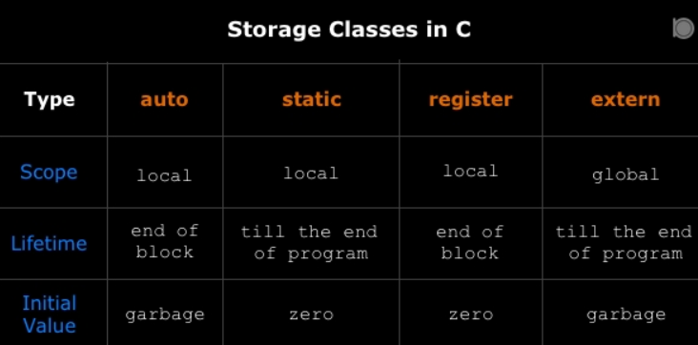

Slide 30
THANK YOU FOR YOUR ATTENTION

